Slide 1
Language models
Large Language Model: A large language model is a type of artificial intelligence model
Transformer: The Transformer is a type of neural network architecture
Language models are trained using a technique called "deep learning," which involves training a large neural network on massive datasets.
How many words trained by chat GPT?
ChatGPT, based on the GPT-3.5 architecture, was trained on a vast amount of data containing 570GB of text. However, it's important to note that the number of words in the training data is not explicitly specified by OpenAI.

Slide 2
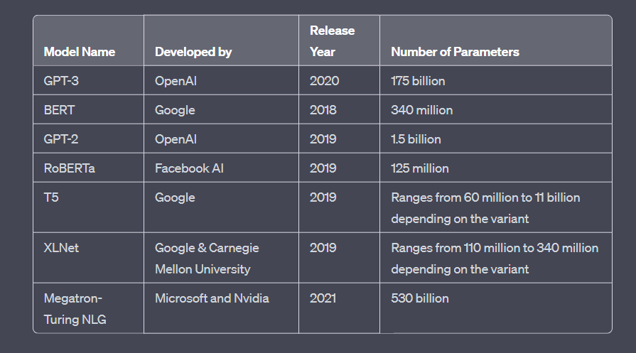
large language models

Slide 3
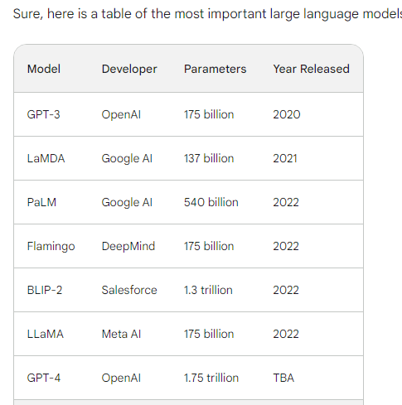
Year | Event
2021 | Bard is first announced by Google AI.
2022 | Bard is released in beta to a small group of users.
2023 | Bard is released to the public in early 2023.
Current | Bard is still under development, but it is learning new things every day.
GPT-3: GPT-3 is a large language model developed by OpenAI. It is one of the most widely used large language models, and it is known for its ability to generate realistic and coherent text.
LaMDA: LaMDA is a large language model developed by Google AI. It is known for its ability to answer questions in an informative way, even if they are open ended, challenging, or strange.
PaLM: PaLM is a large language model developed by Google AI. It is the largest language model in the world, and it is known for its ability to perform a wide range of tasks, including translation, summarization, and code generation.
Flamingo: Flamingo is a large language model developed by DeepMind. It is known for its ability to generate creative text formats, such as poems, code, scripts, musical pieces, email, letters, etc.
BLIP-2: BLIP-2 is a large language model developed by Salesforce. It is known for its ability to understand and respond to natural language queries.
LLaMA: LLaMA is a large language model developed by Meta AI. It is known for its ability to learn from human feedback and improve its performance over time.
GPT-4: GPT-4 is the next generation of GPT-3, and it is expected to be even more powerful and capable.

Slide 4
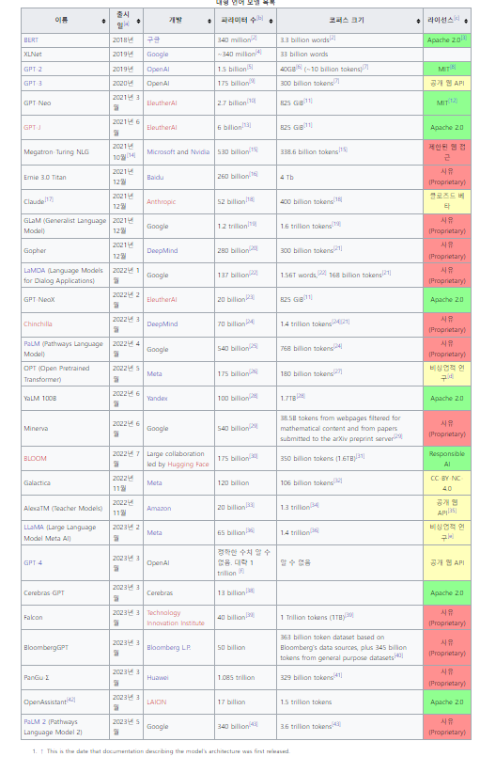
LLM
대형 언어 모델(Large language model, LLM) 또는 거대 언어 모델은 수많은 파라미터(보통 수십억 웨이트 이상)를 보유한 인공 신경망으로 구성되는 언어 모델이다. 자기 지도 학습이나 반자기지도학습을 사용하여 레이블링되지 않은 상당한 양의 텍스트로 훈련된다.^{[1]} LLM은 2018년 즈음에 모습을 드러냈으며 다양한 작업을 위해 수행된다. 이전의 특정 작업의 특수한 지도 학습 모델의 훈련 패러다임에서 벗어나 자연어 처리 연구로 초점이 옮겨졌다.
언어 모델(language model) 또는 언어 모형은 일련의 단어들의 확률 분포이다
A language model in artificial intelligence is a type of model that is trained to understand, generate, and interpret human language.

Slide 5
